Slide 1
Architecting for ML
On AWS
Amazon SageMaker
Emily Webber
January 18, 2018
Notes:
Yes you can ask a question if you have one. I will be stopping periodically to make sure you’re getting what you want and need.

Slide 2
Architecting for Machine Learning Agenda
Day 1
ML on AWS
NLP Lab
Teams
New Problem
Day 2
Feature Engineering
Project
Evaluation
Day 3
Going into Production
Build
Present!
Write Up
New Model
Architecture

Slide 3
Going Into Production
Business | Technology

Slide 4
Each algorithm solves a type of prediction problem
Classification
Computer Vision
Topic Modeling
Linear Learner
XGBoost
KNN
Image Classification
LDA
NTM
Object Detection
Forecasting
DeepAR
Working with Text
Recommendation
Blazing Text
Supervised
Unsupervised
Factorization Machines
Clustering
KMeans
Sequence Translation
Anomaly Detection
Feature Reduction
Seq2Seq
Random Cut Forests
PCA

Slide 5
Where should you start?

Slide 6
Customer Facing
Analysis | Ops | R&D
Classification
Topic Modeling
Computer Vision
Forecasting
Recommendation
Clustering
Working with Text
Feature Reduction
Anomaly Detection
Sequence Translation

Slide 7
Keep Track of Your Ideas
Commit to the Best One

Slide 8
Your Business Expertise
Established Research and Results
Leadership
Ease of finding existing solutions
Revenue
Data

Slide 9
Quality Machine Learning
Critical Path with
Your Customer
Analysis & Operations
Core Research

Slide 10
Working Backwards From The Customer
Who is the customer?
Classification
What do they want?
Your Business Solution
What do I want them to see?
Recommendation
Customer

Slide 11
What insights can I get from my data?
How do I handle edge cases in model performance?
How do I update, replace, retrain, and test my model?
How do I turn my modeling off, to observe it’s impact?
What tools can I use to automate these processes?
How do I share my resources and insights across teams?
Customer
Analysis & Operations
Scientist

Slide 12
R & D Ecosystem
Business
Constantly Improving the Model
Customer’s Response to Model
Academic
Insights from Your Data
Your Team’s Research Contributions
Existing Research in the Field

Slide 13
Going Into Production
Business | Technology

Slide 14
What should I build?
Websites
Mobile
IOT
Robotics
Integrate into Existing Systems

Slide 15
How to do this on AWS?
S3 Hosting
API Gateway
Lambda
Web Servers
Load Balancing
Autoscaling
IOT
Mobile
Robotics
Self-Healing Continuous Integration Pipelines
SageMaker Endpoints
Batch Transform
Nightly Summary Stats
on Model Performance

Slide 16
http://www.shreyasdemos.ml/

Slide 17
Now let’s see what you’ve got. ☺
Thanks!

Slide 18
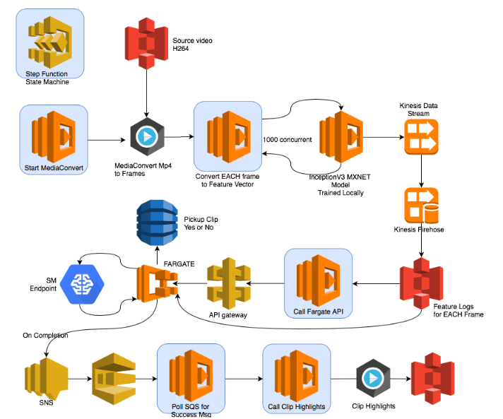
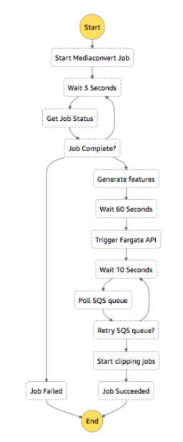

Slide 19
Project Presentations
Project Goal
ETL Strategy
Modeling strategy
Goal for going into production
20 minutes to present, can use slides
Back at 3:00 for presentations at 3:15

